Slide 1
Lecture 6 Logical Design
Relational Model
Logical Design

Slide 2
Outline
Relational Model
Logical Design
Relational Model
Logical Design

Slide 3
Relational Model
Relational Model
Logical Design
After the conceptual design, the database designer will have an ER diagram to model a real-world problem.
Then, the next step is the logical design.
In this phase, the designer needs to specify how data is modeled in a database.
This course introduces the relational model.

Slide 4
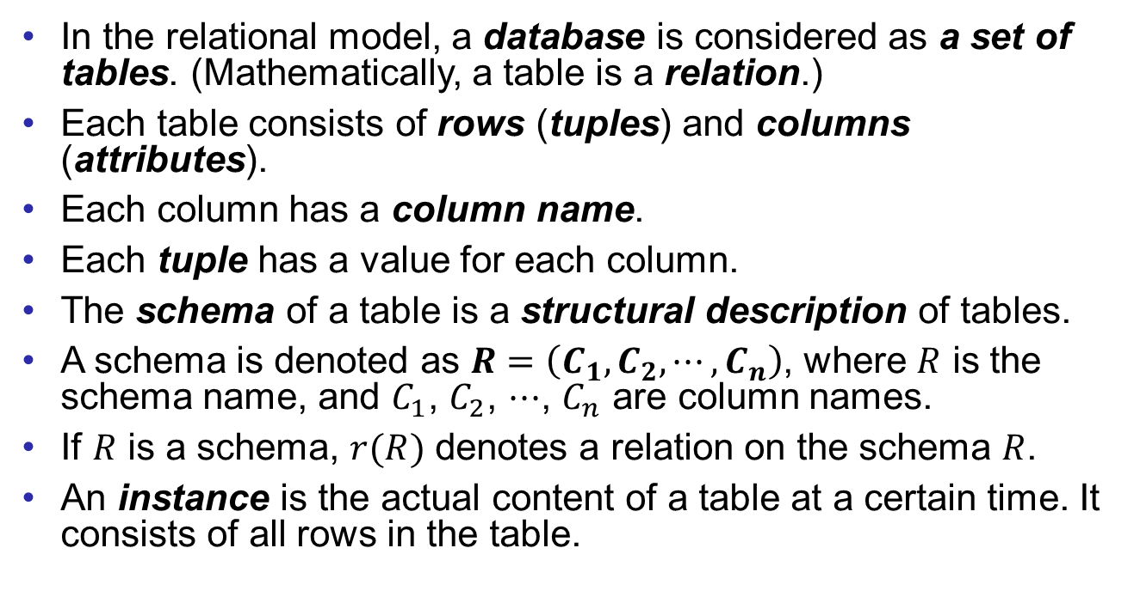
Relational Model
Relational Model
Logical Design
In the relational model, a database is considered as a set of tables. (Mathematically, a table is a relation.)
Each table consists of rows (tuples) and columns (attributes).
Each column has a column name.
Each tuple has a value for each column.
The schema of a table is a structural description of tables.
A schema is denoted as $R=\left(C_{1},C_{2},⋯,C_{n}\right)$, where $R$ is the schema name, and $C_{1}$, $C_{2}$, $⋯$, $C_{n}$ are column names.
If $R$ is a schema, $r(R)$ denotes a relation on the schema $R$.
An instance is the actual content of a table at a certain time. It consists of all rows in the table.

Slide 5
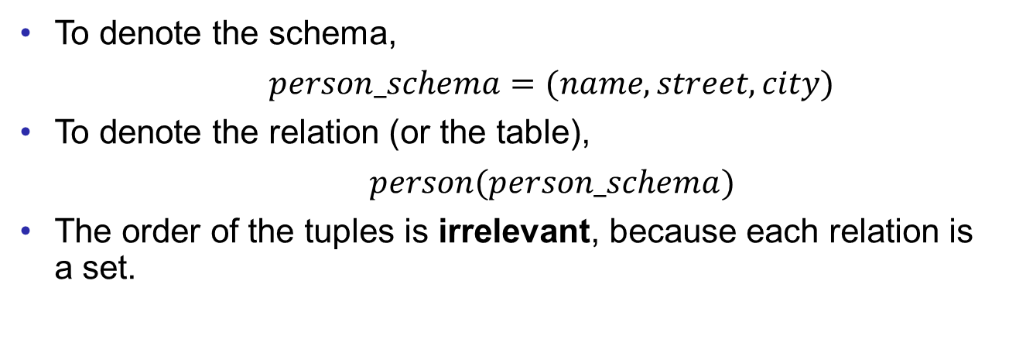

Example
Relational Model
Logical Design
Table: $person$
Column names
Schema
name | street | city
Jones | Main | Harrison
Smith | North | Rye
Lindsay | Park | Pittsfield
Instance
Tuples
To denote the schema,
$person_schema=(name, street, city)$
To denote the relation (or the table),
$person(person_schema)$
The order of the tuples is irrelevant, because each relation is a set.

Slide 6
Relational Model
Relational Model
Logical Design
Before we proceed, you need to remember that
The relational model and the ER model are not parallel. They are modeling different things and for different phases of a database design. You cannot use one to replace the other.
The word “relation” in a relational model is different from the relationships in an ER model.
A relation in a relational model is strictly defined in mathematics.
An attribute in a relational model is also different from an attribute in an ER model, even they look very similar.

Slide 7
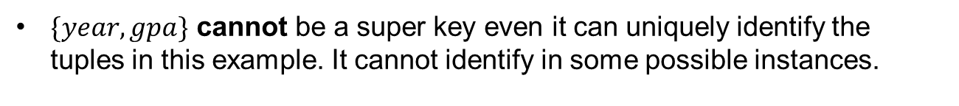
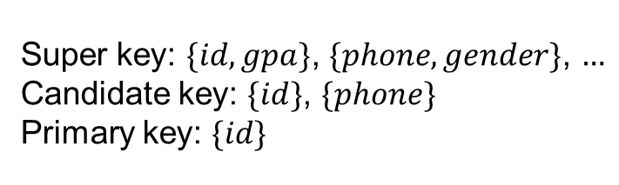
Keys
Relational Model
Logical Design
The super key of a schema is a set of attributes that uniquely identifies each tuple in a relation for any instance.
The candidate key is a minimal (not minimum) super key.
The primary key is a candidate key that is the most appropriate to become the main key of the relation, never or rarely changed.
Table: student
Super key: $\{id, gpa\}$, $\{phone, gender\}$, $…$
Candidate key: $\{id\}$, $\{phone\}$
Primary key: $\{id\}$
id | name | year | gpa | phone | major
123 | Richard | 2 | 3.9 | 1342225648 | CST
234 | Grace | 3 | 3.4 | 1526482319 | DS
345 | Bob | 3 | 3.2 | 1865482164 | AI
$\{year, gpa\}$ cannot be a super key even it can uniquely identify the tuples in this example. It cannot identify in some possible instances.

Slide 8
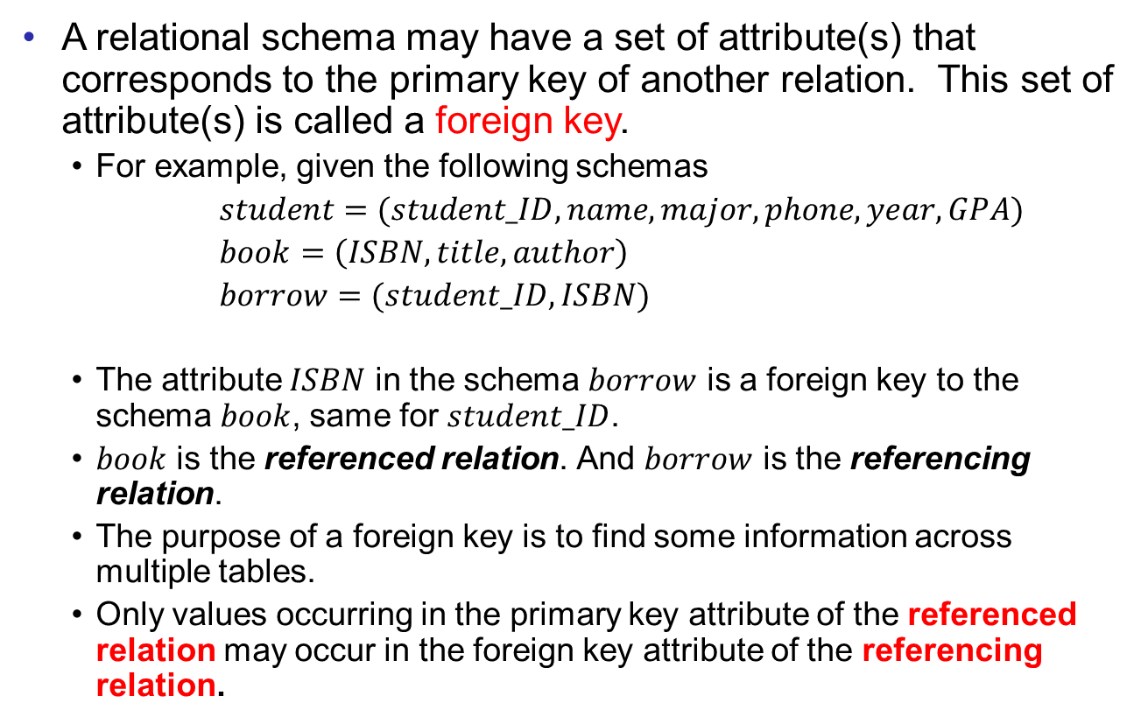
Foreign Keys
Relational Model
Logical Design
A relational schema may have a set of attribute(s) that corresponds to the primary key of another relation. This set of attribute(s) is called a foreign key.
For example, given the following schemas
$student=(student_ID,name,major,phone,year,GPA)$
$book=\left(ISBN,title,author\right)$
$borrow=(student_ID,ISBN)$
The attribute $ISBN$ in the schema $borrow$ is a foreign key to the schema $book$, same for $student_ID$.
$book$ is the referenced relation. And $borrow$ is the referencing relation.
The purpose of a foreign key is to find some information across multiple tables.
Only values occurring in the primary key attribute of the referenced relation may occur in the foreign key attribute of the referencing relation.

Slide 9
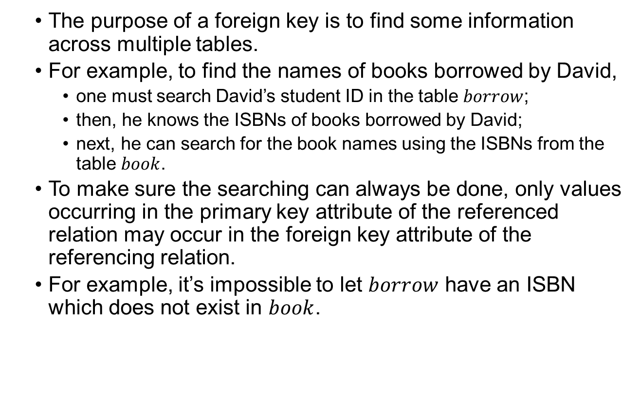
Foreign Keys
Relational Model
Logical Design
The purpose of a foreign key is to find some information across multiple tables.
For example, to find the names of books borrowed by David,
one must search David’s student ID in the table $borrow$;
then, he knows the ISBNs of books borrowed by David;
next, he can search for the book names using the ISBNs from the table $book$.
To make sure the searching can always be done, only values occurring in the primary key attribute of the referenced relation may occur in the foreign key attribute of the referencing relation.
For example, it’s impossible to let $borrow$ have an ISBN which does not exist in $book$.

Slide 10
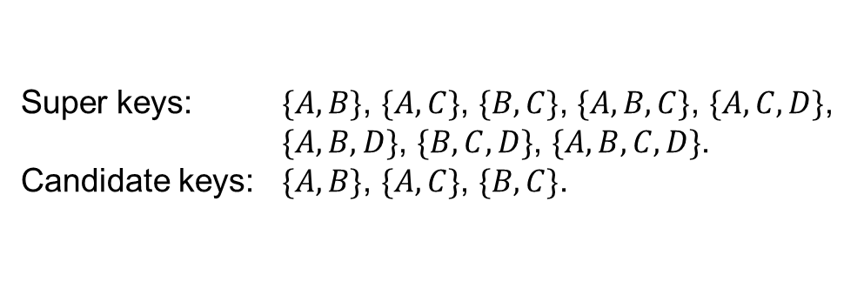
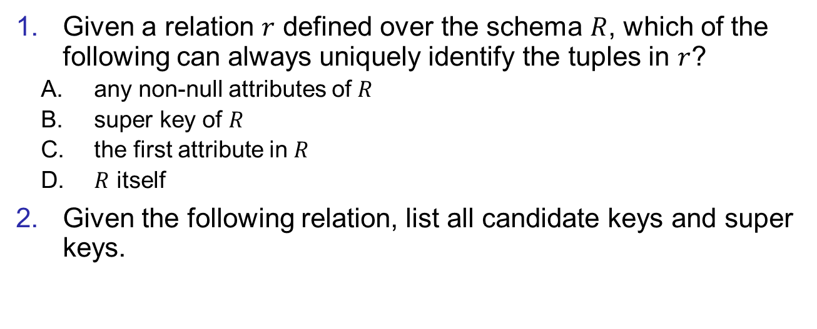
Exercise
Relational Model
Logical Design
Given a relation $r$ defined over the schema $R$, which of the following can always uniquely identify the tuples in $r$?
any non-null attributes of $R$
super key of $R$
the first attribute in $R$
$R$ itself
Given the following relation, list all candidate keys and super keys.
Super keys: $\{A,B\}$, $\{A,C\}$, $\{B,C\}$, $\{A,B,C\}$, $\{A,C,D\}$,
$\{A,B,D\}$, $\{B,C,D\}$, $\{A,B,C,D\}$.
Candidate keys: $\{A,B\}$, $\{A,C\}$, $\{B,C\}$.
A | B | C | D
A1 | B1 | C1 | D1
A1 | B2 | C2 | D1
A2 | B1 | C2 | D1

Slide 11
Logical Design
Relational Model
Logical Design
Now, we are ready to convert ER diagrams to relational models.
The basic ideas are as follows.
Build one schema for each entity set.
Build one schema for each relationship set only if necessary (depends on the constraints).
One attribute for schemas is one attribute in the ER diagram.
Take care of keys.
The goals of the conversion
Preserve all information (from the physical world)
Maintain the constraints to the extent possible
Minimize redundancies and NULL values
Relational Model cannot preserve all constraints

Slide 12
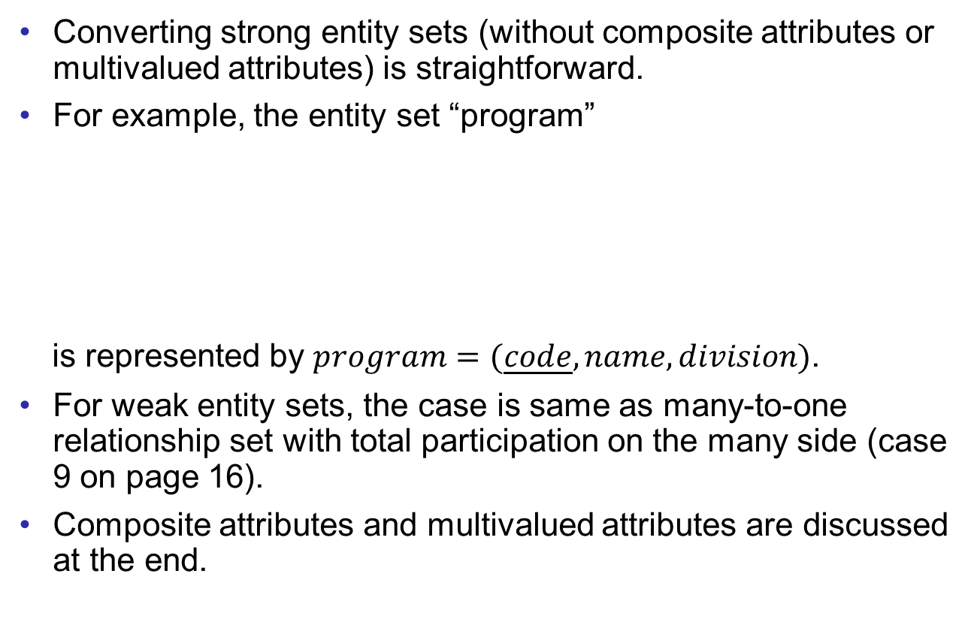
Entity Sets
Relational Model
Logical Design
Converting strong entity sets (without composite attributes or multivalued attributes) is straightforward.
For example, the entity set “program”
is represented by $program=(\underline{code}, name,division)$.
For weak entity sets, the case is same as many-to-one relationship set with total participation on the many side (case 9 on page 16).
Composite attributes and multivalued attributes are discussed at the end.
code
name
program
division

Slide 13
Relationship Sets
Relational Model
Logical Design
Different constraints make the conversion of relationship sets different.
Here we list all different cases of the constraints. (10 in total)
1. many-to-many without total participation
R
2. many-to-many with total participation on one side
R
3. many-to-many with total participation on both sides
R

Slide 14
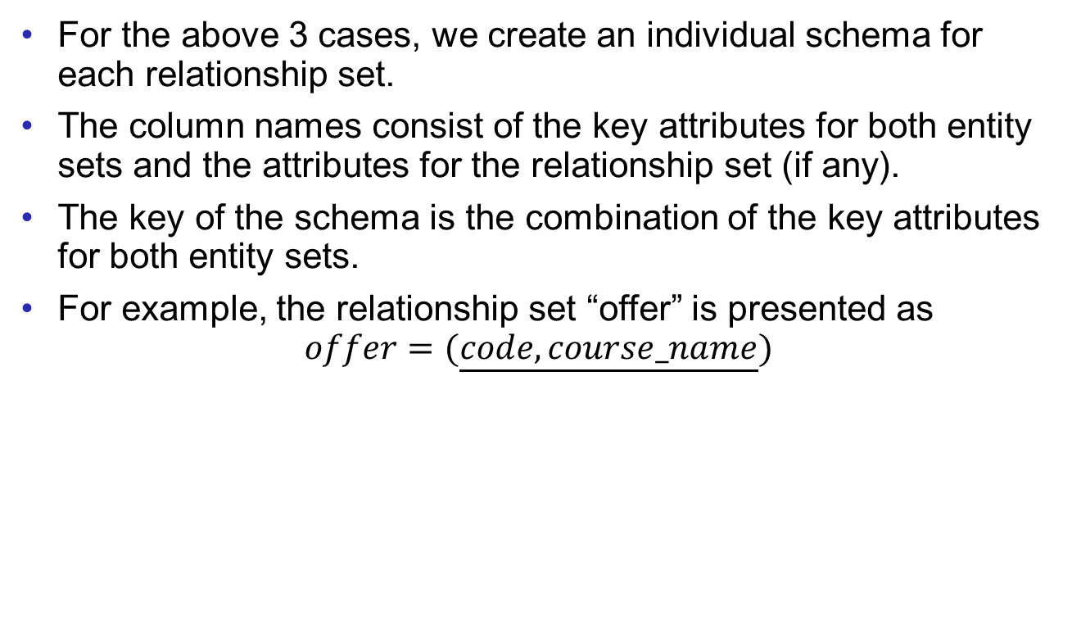
Relationship Sets
Relational Model
Logical Design
For the above 3 cases, we create an individual schema for each relationship set.
The column names consist of the key attributes for both entity sets and the attributes for the relationship set (if any).
The key of the schema is the combination of the key attributes for both entity sets.
For example, the relationship set “offer” is presented as
$$offer=(\underline{code, course_name})$$
code
course_name
program
offer
course

Slide 15
Relationship Sets
Relational Model
Logical Design
More cases:
For these three cases, the conversion is same as the previous cases.
But the key of the schema is
either one of the key attributes of the entity sets (case 4);
the key attribute of the entity set on the “many” side (case 5 and 6).
4. one-to-one without total participation
R
5. one-to-many without total participation
R
6. one-to-many with total participation on the “one” side
R

Slide 16
Relationship Sets
Relational Model
Logical Design
More cases:
7. one-to-one with one total participation
and one partial participation
R
8. one-to-one with total participation on both sides
R
9. one-to-many with total participation on the “many” side
R
10. one-to-many with total participation on both sides
R

Slide 17
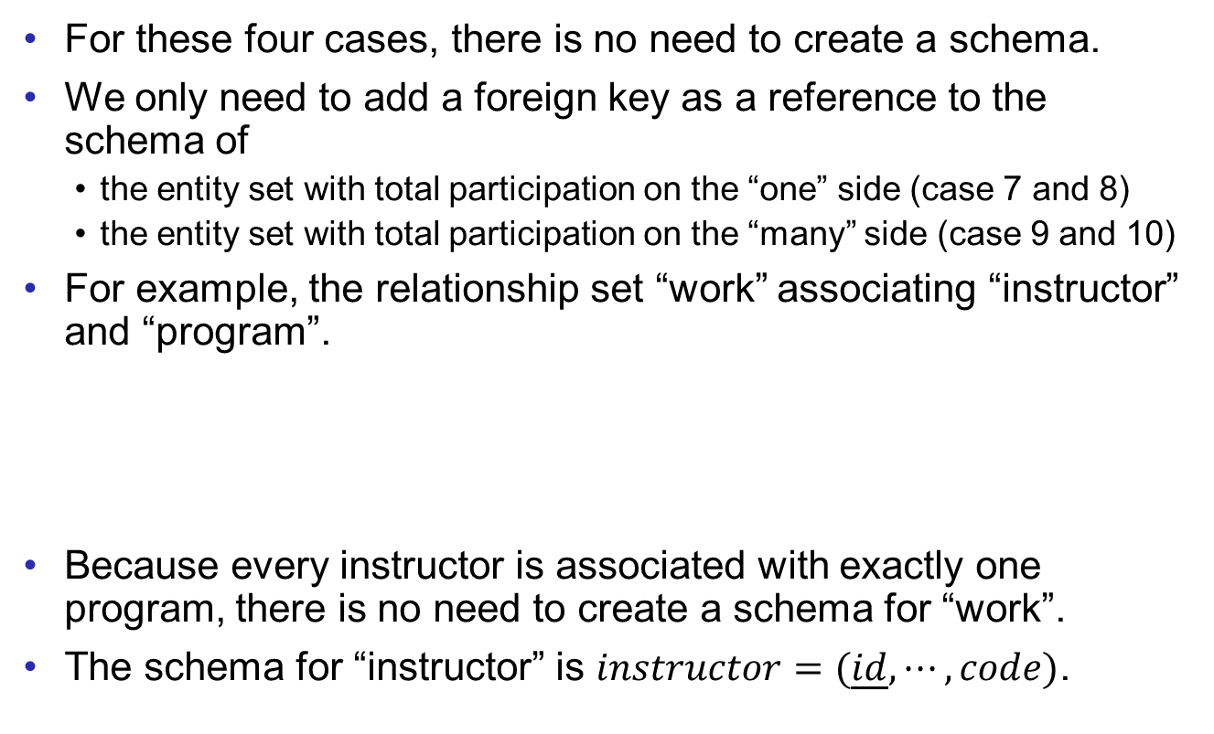
Relationship Sets
Relational Model
Logical Design
For these four cases, there is no need to create a schema.
We only need to add a foreign key as a reference to the schema of
the entity set with total participation on the “one” side (case 7 and 8)
the entity set with total participation on the “many” side (case 9 and 10)
For example, the relationship set “work” associating “instructor” and “program”.
Because every instructor is associated with exactly one program, there is no need to create a schema for “work”.
The schema for “instructor” is $instructor=(\underline{id},⋯,code)$.
id
code
instructor
work
program
foreign key

Slide 18
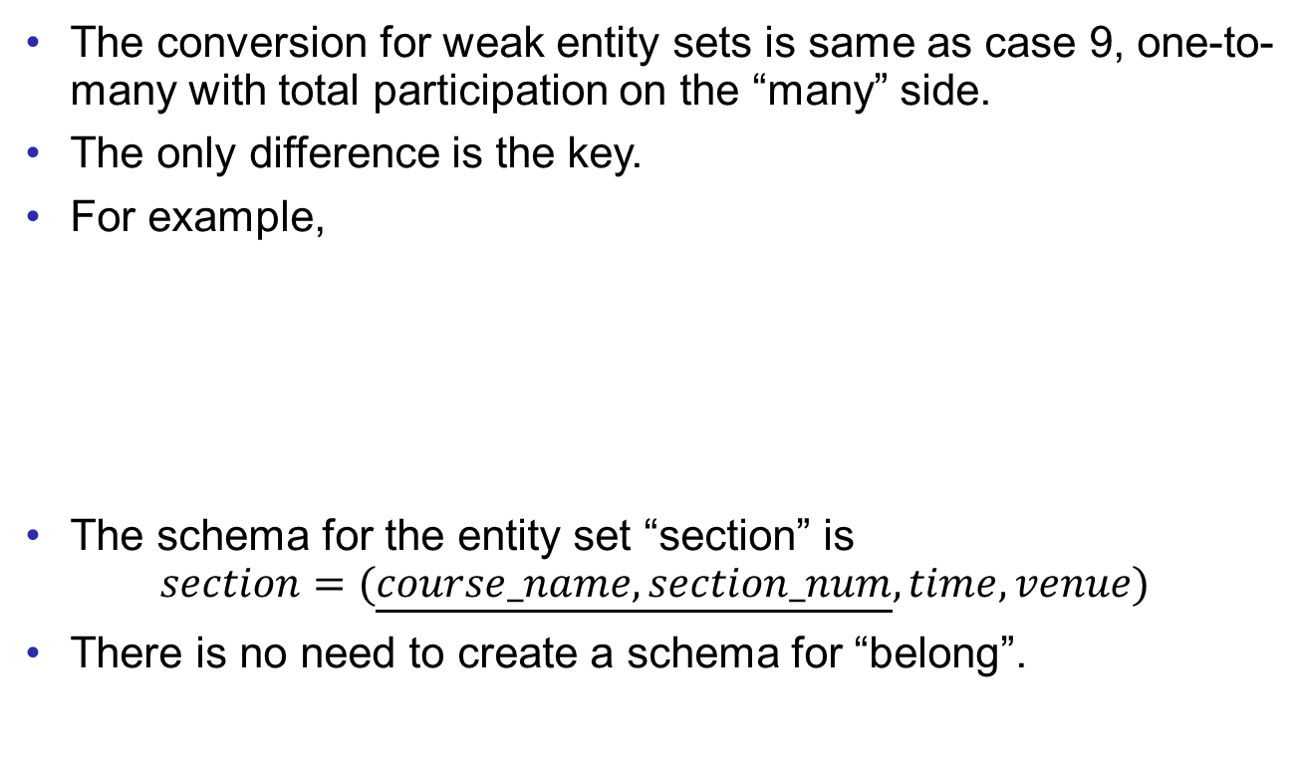
Relationship Sets
Relational Model
Logical Design
The conversion for weak entity sets is same as case 9, one-to-many with total participation on the “many” side.
The only difference is the key.
For example,
The schema for the entity set “section” is
$$section=(\underline{course_name,section_num},time,venue)$$
There is no need to create a schema for “belong”.
course_name
section_number
time
course
belong
section
venue

Slide 19
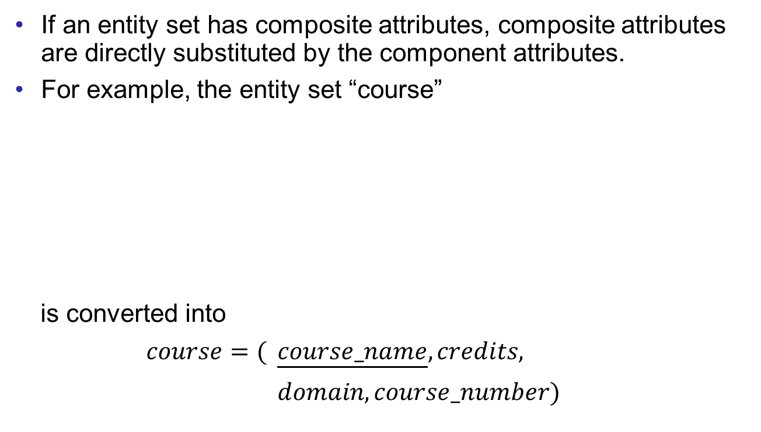
Composite Attribute
Relational Model
Logical Design
If an entity set has composite attributes, composite attributes are directly substituted by the component attributes.
For example, the entity set “course”
is converted into
$course=($ $\underline{course_name},credits,$
$domain,course_number)$
credits
course_name
course
course_code
domain
course_number

Slide 20
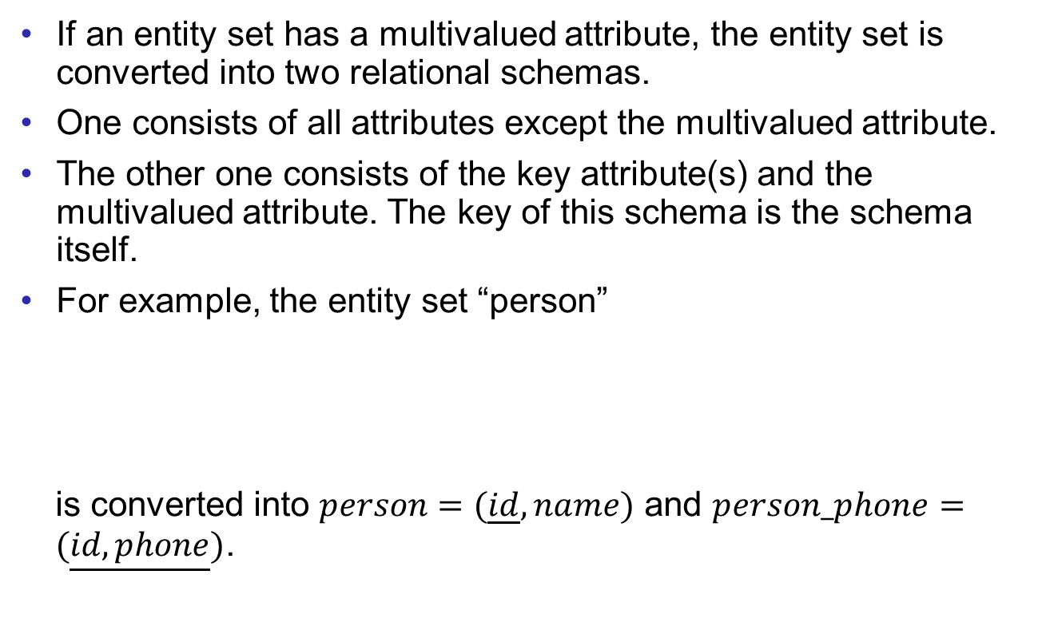
Multivalued Attributes
Relational Model
Logical Design
If an entity set has a multivalued attribute, the entity set is converted into two relational schemas.
One consists of all attributes except the multivalued attribute.
The other one consists of the key attribute(s) and the multivalued attribute. The key of this schema is the schema itself.
For example, the entity set “person”
is converted into $person=(\underline{id},name)$ and $person_phone=(\underline{id,phone})$.
name
id
phone
person

Slide 21
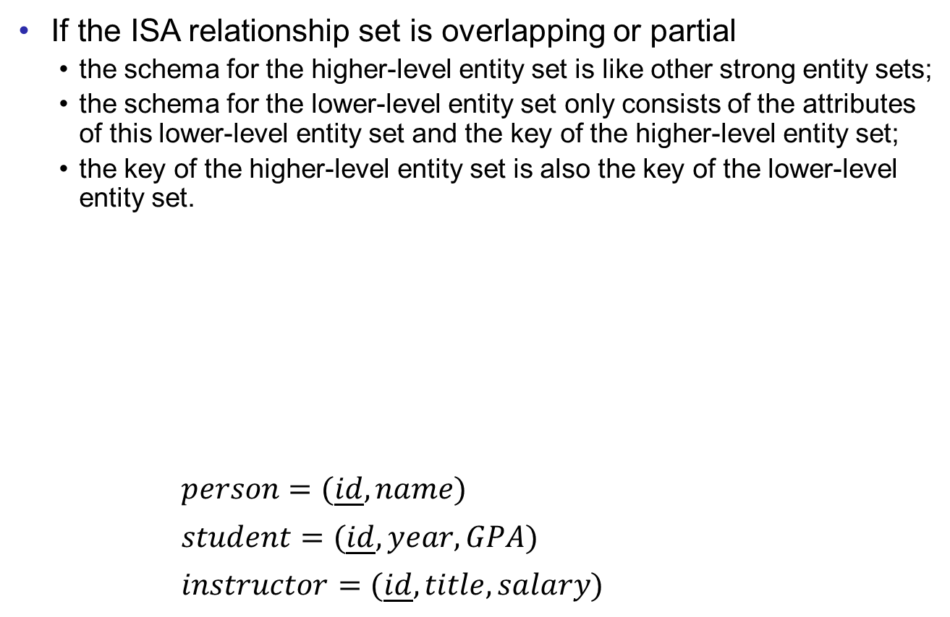
ISA Relationship Sets
Relational Model
Logical Design
If the ISA relationship set is overlapping or partial
the schema for the higher-level entity set is like other strong entity sets;
the schema for the lower-level entity set only consists of the attributes of this lower-level entity set and the key of the higher-level entity set;
the key of the higher-level entity set is also the key of the lower-level entity set.
$person=(\underline{id}, name)$
$student=(\underline{id},year,GPA)$
$instructor=(\underline{id},title,salary)$
id
name
Assume that the multivalued attribute “phone” is omitted, and the ISA is not disjoint.
person
year
title
ISA
GPA
salary
student
instructor

Slide 22

ISA Relationship Sets
Relational Model
Logical Design
If the ISA relationship set is disjoint and total
no need to create a schema for the entity set on the higher level;
one schema is constructed for each entity set on the lower level, inheriting all attribute from the higher-level entity set.
$student=(\underline{id},name,year,GPA)$
$instructor=(\underline{id},name,title,salary)$
id
name
person
year
title
ISA
disjoint
GPA
salary
student
instructor

Slide 23
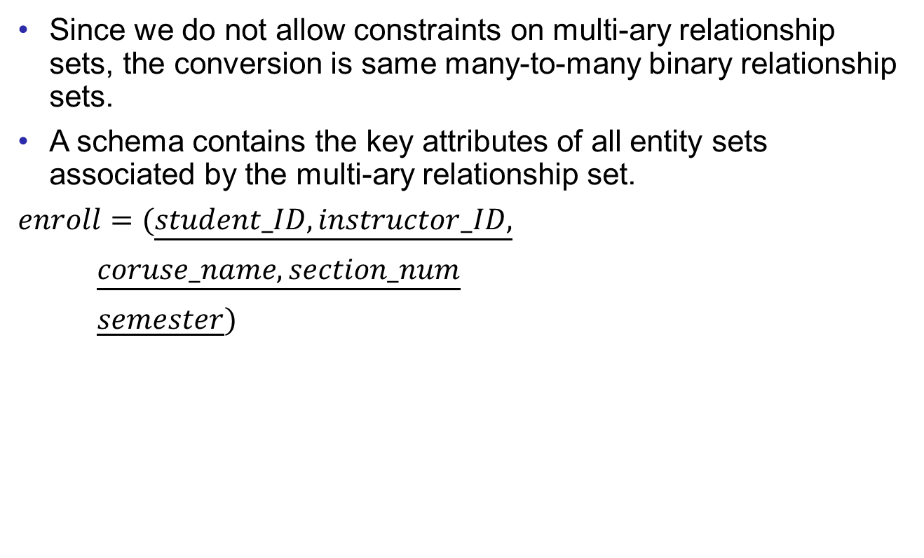
Multi-ary Relationship Sets
Relational Model
Logical Design
Since we do not allow constraints on multi-ary relationship sets, the conversion is same many-to-many binary relationship sets.
A schema contains the key attributes of all entity sets associated by the multi-ary relationship set.
$enroll=(\underline{student_ID,instructor_ID,}$
$\underline{coruse_name,section_num}$
$\underline{semester})$
name
person
id
GPA
ISA
title
year
salary
student
enroll
instructor
course_name
course
belong
section
section_number
semester

Slide 24
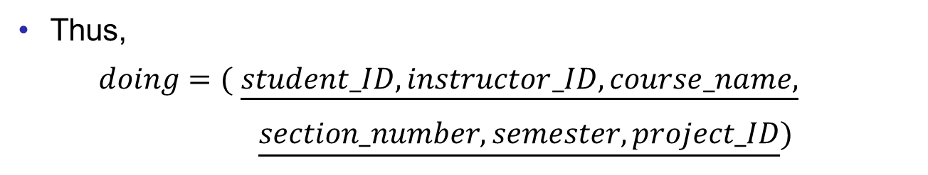
Aggregation
Relational Model
Logical Design
Aggregations are treated same as other relationship sets.
For example, the schema for “enroll” has the key of “instructor”, “student”, and “section”.
Then, “doing” is a binary many-to-many relationship set. And the method for case 1 can be applied.
instructor
student
enroll
section
doing
project
Thus,
$doing=($ $\underline{student_ID,instructor_ID,course_name,}$
$\underline{section_number,semester,project_ID})$

Slide 25
Comments
Relational Model
Logical Design
Sometimes different entity sets may have some attributes of the same name (of course different meanings).
It’s fine to rename the attributes in the logical design to distinguish them.
For example, we rename the IDs for students and instructors on the last page.

Slide 26
Exercises
Relational Model
Logical Design
On page 16, if the relationship set is one of the case 7-10, there is no need to create a relational schema for the relationship set. What will happen if this method is applied to case 1-6?
On page 20, we create two schemas for the entity sets with a multivalued attribute. What will happen if the two schema are combined as one?
Given the ER diagram for the UIC database (on the next page), which is the outcome of the exercise of the last lecture. Please translate the diagram into relational schemas. Part of it is already done in the examples.

Slide 27
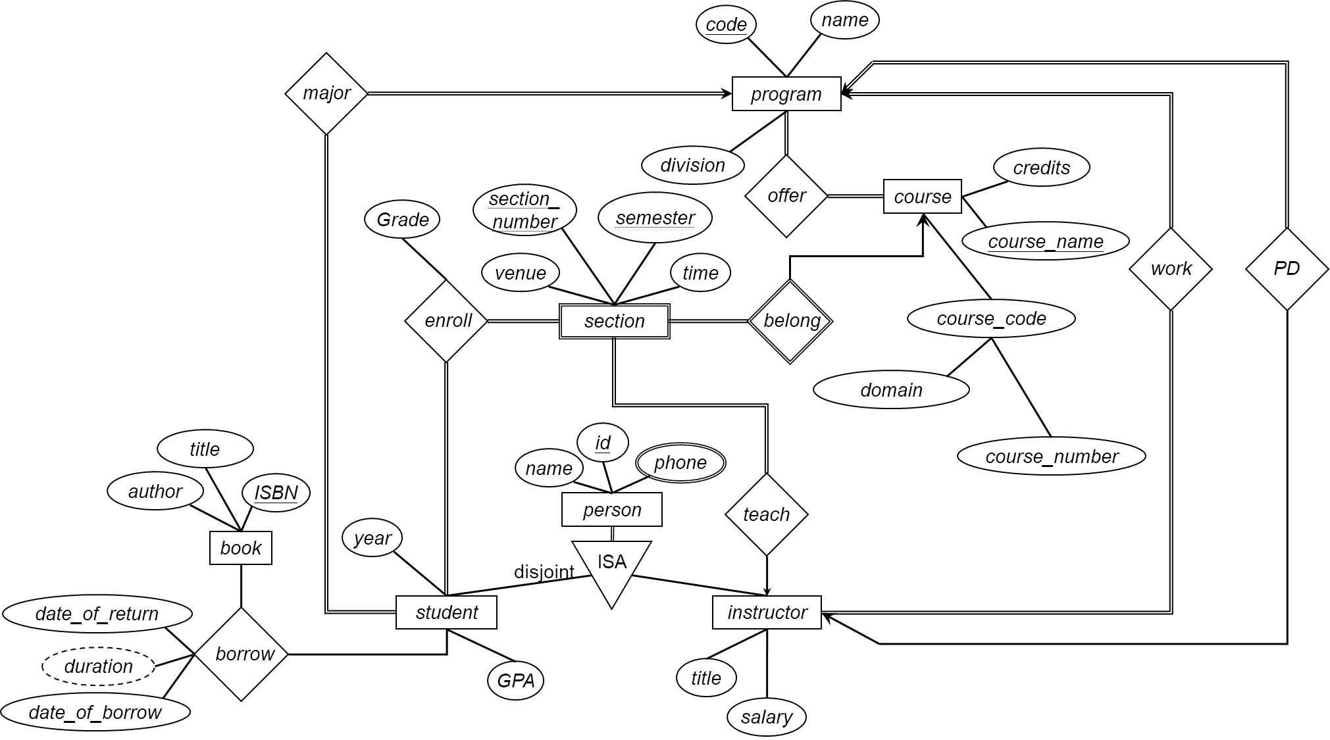
Exercise
Relational Model
Logical Design

Slide 28
End of Lecture 6
Relational Model
Logical Design

